Slide 1
How to Stop the 4th Wave of Epidemic in Hong Kong?
ZHAO Yuqing
csyzhao1@comp.polyu.edu.hk
Notes:
What are the condition for epidemic to start

Slide 2
Outline
Background
Possible factors
Virus transmission potential
Policy intervention
People related factors
Spatial location attribute
Concerns towards possible factors
Answers to the concerns

Slide 3


Background
Hong Kong is enduring the Covid-19
The fourth wave of outbreaks has hit Hong Kong.
The number of confirmed cases exceeded 100 for days
Anti-epidemic policies was passive and lenient
Policies were relaxed every time infection number drops below 10
Multiple exemptions from quarantine and testing
Voluntary "citizen-wide" Covid-19 testing
Notes:
Recently, the 4th wave of covid-19 outbreak has hit Hong Kong
And the daily confirmed cases has exceeded a hundred
We have survived the former 3 wave of outbreak. And I think the reason to the repeating waves is the reactive and lenient policies of Hong Kong.

Slide 4
Possible Factors
Virus transmission potential
Policy intervention
People related factors
Spatial location attribute
Notes:
Three days before, we have discussed about the possible factors that might influence the epidemic situation in order to build a model.
Here I have summarized them into 4 groups

Slide 5


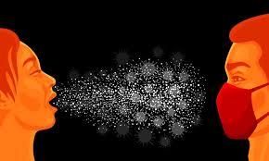
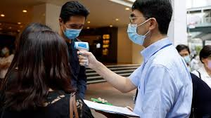
Possible Factors
Virus transmission potential
Infection rates
Evolution of virus infectivity
Virus transmission distance
Contagious periods
Susceptibility
Bias
Policy intervention
Open for entertainment
Dine-in rules
Isolation time
Immigration policy
Citizen-wide testing
Notes:
I think the first important step is to understand the transmission potential of covid-19
Like the infection rate, the transmission distance, the contagious period. Will the infectivity evolve with covid-19? Will the infection have bias?
Also, I think Hong Kong’s policy former intervention was quite effective, since we had decreased the confirmed cases below 10 repeatedly.
Duration: The longer a person is sick, the longer they will be able to infect others. The sooner the person is isolated, the less chance he has of infecting others.
Reproductive number: Number of secondary infections caused by an infected person
Susceptibility: When the virus is transmitted to another person, what is the likelihood that person will be infected? Since novel Coronavirus currently has no protection mechanism or vaccine against it, its susceptibility is nearly 100 percent.

Slide 6



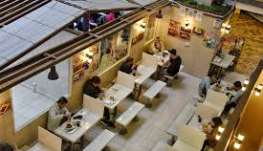
Possible Factors
People related factors
The population density
The number of infections tested per day
Number of uninfected persons
Number of hospital tests per day
Demographic
Spatial location attribute
Time spent together
Whether masks are allowed to be taken off
Contact distance
Corresponding intervention policies
Notes:
And social network of people and location that we go can also have an impact on transmission of covid-19
The actual number of confirmed infections: It depends on a country's testing capacity and how many people are willing to be tested.
Demographic: (place to go, distance to walk, behavior)

Slide 7
Concerns towards Possible Factors
Will the infectivity change over time? (known)
How many people can one person infect? (known)
Under what conditions will the outbreak be under control? (known)
When does a virus become more or less contagious as it mutates?
Distance of disease transmission(known)
How effective interventions can be? (known)
Testing capacity in Hong Kong
How many people are willing to test for suspicious symptoms?
The amount of time a person is contagious(known)
Notes:
Here we came up with some concerns about the virus transmission potential, and the characteristic of the epidemic in Hong Kong.

Slide 8
To answer the questions
Notes:
This few days I managed to do a little bit literature reviews to answer the questions

Slide 9
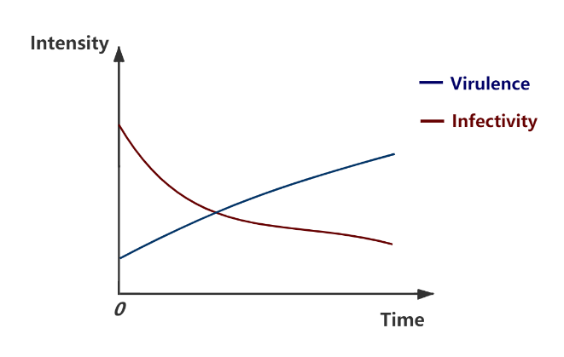

Will the infectivity change over time?
Changes in viral Infectivity and Virulence over Time
The virulence of the virus decreased significantly in the early stage [1]
The transmissibility increases ($R_{0}$without intervention) [2]
[1] Lion, Sébastien, and Johan AJ Metz. "Beyond R0 maximisation: on pathogen evolution and environmental dimensions." Trends in ecology & evolution 33.6 (2018): 458-473.
[2] Alizon, Samuel, et al. "Virulence evolution and the trade‐off hypothesis: history, current state of affairs and the future." Journal of evolutionary biology 22.2 (2009): 245-259.
Notes:
First, to answer the question
(Can not be quantified)

Slide 10
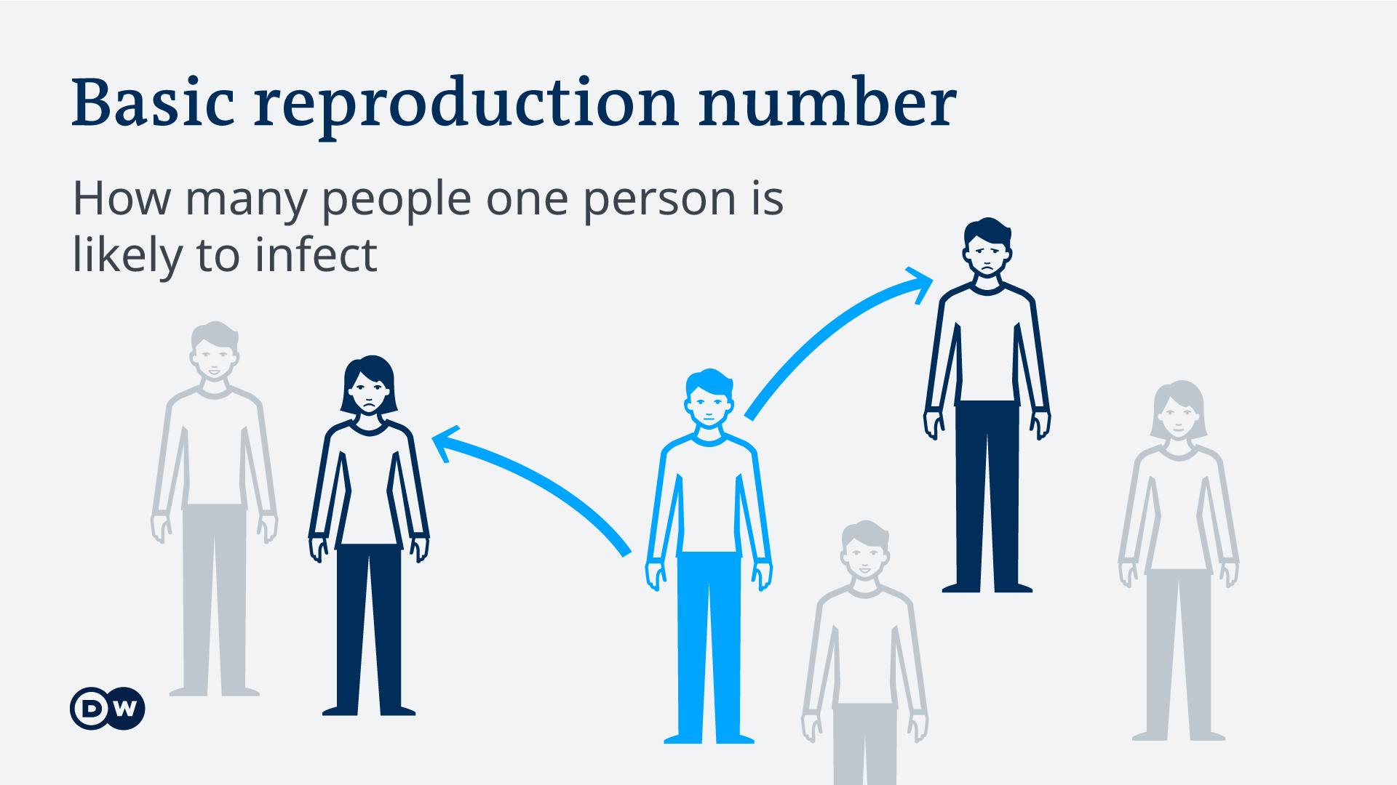
How many people can one person infect?

Slide 11

How many people can one person infect?
Basic reproduction Number $R_{0}$
For COVID-19, the reproductive number should be between 2 and 2.5, higher than for influenza. [1]
Preliminary assessment of the transmission dynamics of COVID-19 shows that the basic reproductive number ($R_{0}$) of 2019-NCOV is estimated at 1.4-3.9 [2]
3.8 to 8.9 (without intervention in June 2020) [3] After the intervention, 1.4 to 3.8 [4]
[1]‘Coronavirus disease (COVID-19): Similarities and differences with influenza’. https://www.who.int/news-room/q-a-detail/coronavirus-disease-covid-19-similarities-and-differences-with-influenza (accessed Dec. 08, 2020).
[2]J. Sun et al., ‘COVID-19: Epidemiology, Evolution, and Cross-Disciplinary Perspectives’, Trends Mol. Med., vol. 26, no. 5, pp. 483–495, May 2020, doi: 10.1016/j.molmed.2020.02.008.
[3]Sanche, Steven; Lin, Yen Ting; Xu, Chonggang; Romero-Severson, Ethan; Hengartner, Nick; Ke, Ruian. Early Release - High Contagiousness and Rapid Spread of Severe Acute Respiratory Syndrome Coronavirus 2 - Volume 26, Number 7—July 2020 - Emerging Infectious Diseases journal - CDC. [2020-06-12]. doi:10.3201/eid2607.200282.
[4] Read, Jonathan M.; Bridgen, Jessica R.E.; et al. Novel coronavirus 2019-nCoV: early estimation of epidemiological parameters and epidemic predictions. 2020.01.23. doi:10.1101/2020.01.23.20018549.

Slide 12
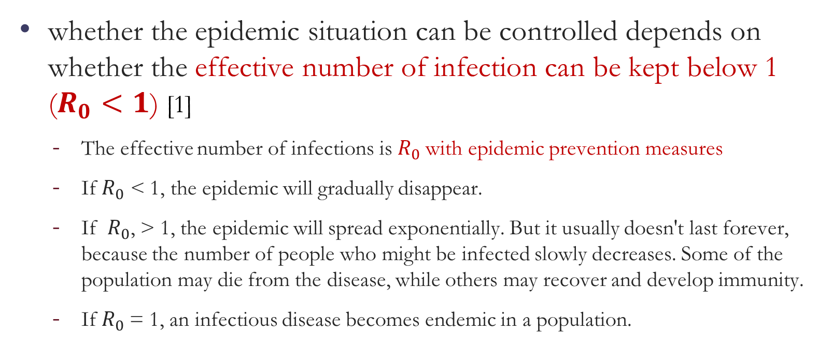
Under what conditions will the outbreak be under control?
whether the epidemic situation can be controlled depends on whether the effective number of infection can be kept below 1 ($R_{0}<1$) [1]
The effective number of infections is $R_{0}$with epidemic prevention measures
If $R_{0}$ < 1, the epidemic will gradually disappear.
If $R_{0}$, > 1, the epidemic will spread exponentially. But it usually doesn't last forever, because the number of people who might be infected slowly decreases. Some of the population may die from the disease, while others may recover and develop immunity.
If $R_{0}$= 1, an infectious disease becomes endemic in a population.
[1] Wallinga J, Teunis P. Different epidemic curves for severe acute respiratory syndrome reveal similar impacts of control measures. Am. J. Epidemiol. 2004, 160 (6): 509–16. PMID 15353409. doi:10.1093/aje/kwh255.

Slide 13
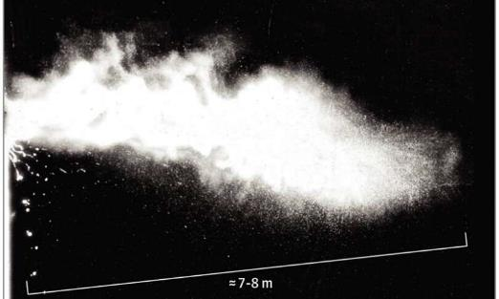
Distance of disease transmission
Gas clouds caused by exhalation can travel up to 27 feet (8.2 meters)[1]
The measures requested by the CENTERS for Disease Control and Prevention and the World Health Organization require 0.9 m and 1.8 m of space, respectively
[1]L. Bourouiba, ‘Turbulent Gas Clouds and Respiratory Pathogen Emissions: Potential Implications for Reducing Transmission of COVID-19’, JAMA, Mar. 2020, doi: 10.1001/jama.2020.4756.

Slide 14
How effective interventions can be?
It is feasible to reduce risk by physical distancing [1]
At a body distance of 1 m, the risk was reduced by 82%.
Each increase of 1 m interval will more than double the relative protection degree. The available data is up to 3 m.
It is feasible to reduce risk by wearing mask and eye protection[1]
Masks and respirators reduced the risk of infection by 85% and were more effective in medical institutions than in the community.
Another important finding of Chu and colleagues for health workers is that protecting the eyes reduces infections by 78%
[1] C. R. MacIntyre and Q. Wang, ‘Physical distancing, face masks, and eye protection for prevention of COVID-19’, The Lancet, vol. 395, no. 10242, pp. 1950–1951, Jun. 2020, doi: 10.1016/S0140-6736(20)31183-1.

Slide 15
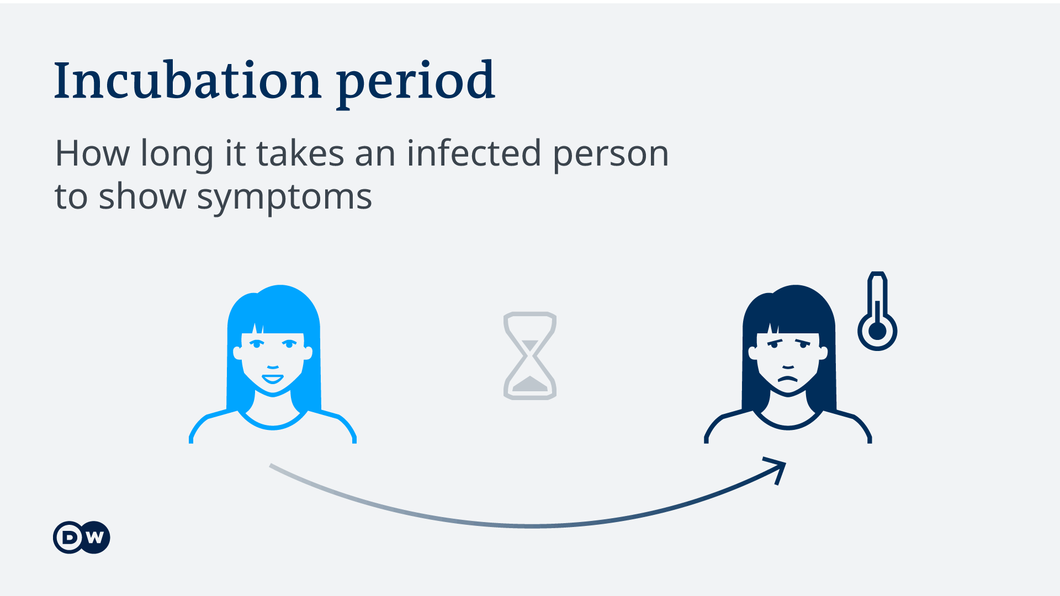
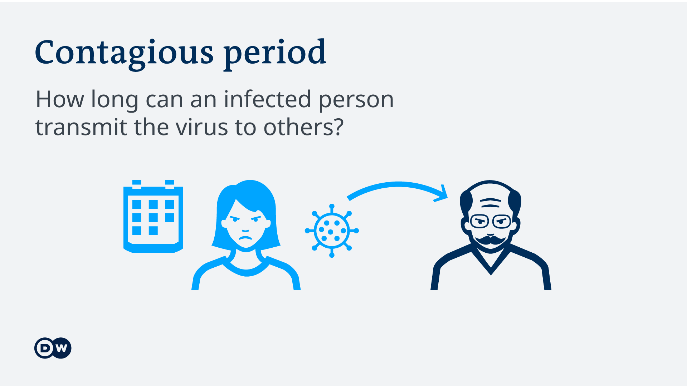
The amount of time a person is contagious

Slide 16
The amount of time a person is contagious
Incubation period[1]
The average incubation period was 5.2 days
The 95th percentile of the distribution is 12.5 days
An unusual situation was also reported, with an incubation period of 19 days.
14 days of isolation is recommended.
Contagious period[2][3]
Once an infected person shows symptoms, in mild cases, the infection lasts between 7 and 12 days. If the symptoms are severe, they can be contagious for more than two weeks.
COVID-19 patients can begin to transmit the virus 24 to 48 hours before symptom onset
A study from Shenzhen, found that a quarter of infections were transmitted by asymptomatic carriers.
[1] P. Zhai, Y. Ding, X. Wu, J. Long, Y. Zhong, and Y. Li, ‘The epidemiology, diagnosis and treatment of COVID-19’, Int. J. Antimicrob. Agents, vol. 55, no. 5, p. 105955, May 2020, doi: 10.1016/j.ijantimicag.2020.105955
[2] Estimation of the transmission risk of 2019-nCov and its implication for public health interventions Biao Tang , Xia Wang , Qian Li , Nicola Luigi Bragazzi , Sanyi Tang , Yanni Xiao Jianhong Wu
[3] Novel coronavirus 2019-nCoV: early estimation of epidemiological parameters and epidemic predictions Jonathan M. Read , Jessica R.E. Bridgen , Derek A.T. Cummings , Antonia Ho, Chris P. Jewell

Slide 17


Slide 18
How to Let Computer Make Decision Basing on Fused Knowledge
ZHAO Yuqing
csyzhao1@comp.polyu.edu.hk

Slide 19
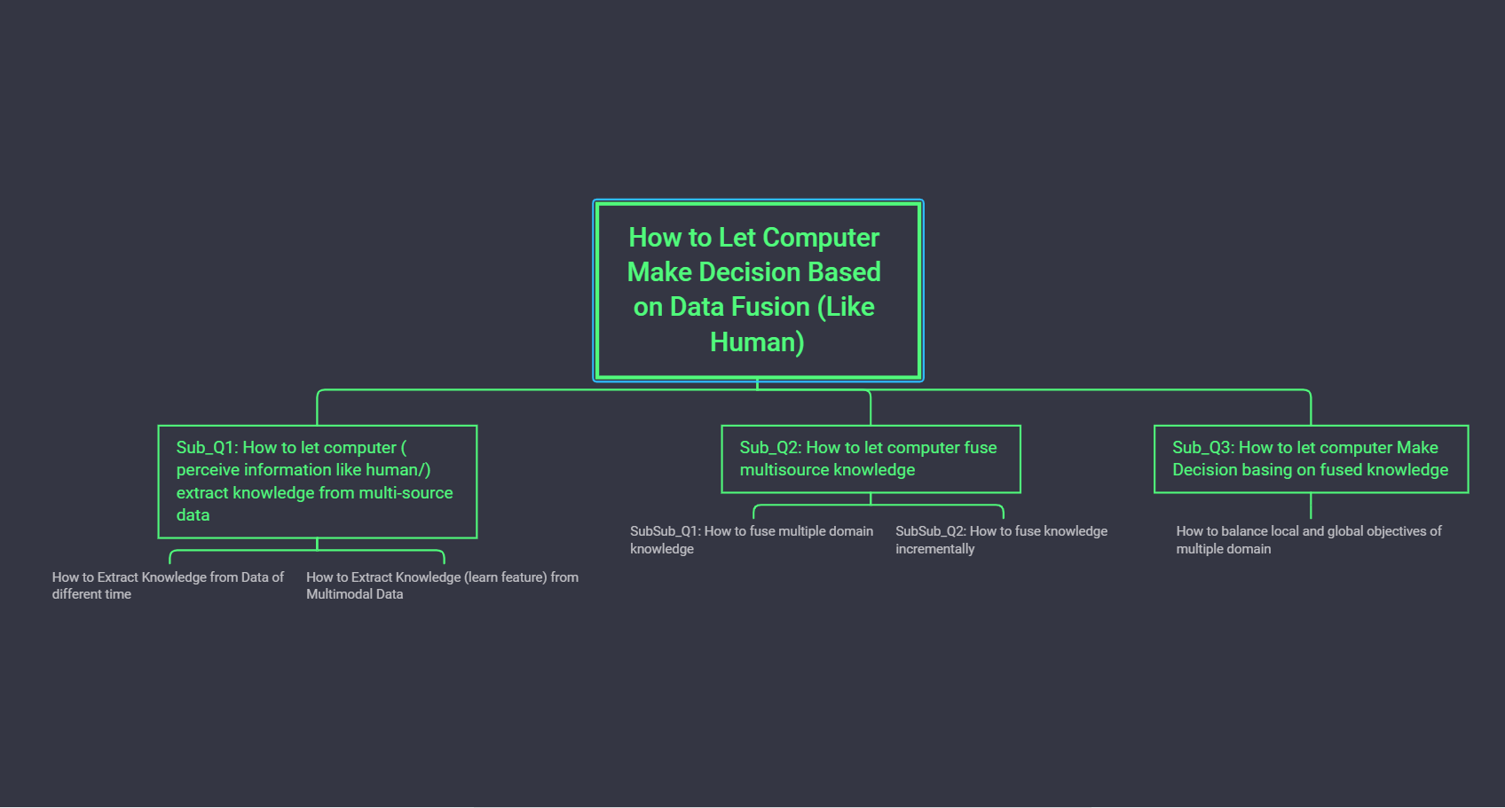

Slide 20
Outline
Background
Motivation
Problem Illustration
Challenge

Slide 21
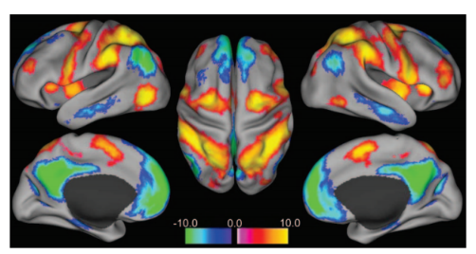
Background
We use two brain networks in our daily decision making[1][2]
Default Network: activated when meditating and remembering the past
Executive Network: activated while dealing with more complex tasks that require more cognitive resources, such as answering questions or rushing to a plan
Interaction between the default network and executive network promotes creativity[3]
Fig1. The cool color area is the default network related area
The warm color area is the relevant area of the executive network
[1] Christoff K, Gordon A M, Smallwood J, et al. Experience sampling during fMRI reveals default network and executive system contributions to mind wandering[J]. Proceedings of the National Academy of Sciences, 2009, 106(21): 8719-8724.
[2] Mittner M, Hawkins G E, Boekel W, et al. A neural model of mind wandering[J]. Trends in cognitive sciences, 2016, 20(8): 570-578.
[3] Beaty R E, Benedek M, Kaufman S B, et al. Default and executive network coupling supports creative idea production[J]. Scientific reports, 2015, 5: 10964.
Notes:
Generally, the default network and execution network of the brain are one after the other. When one is activated, the other is often dormant.
Co-activation of default and executive networks may thus reflect both focused internal attention and the executive control of thought content.
[4] Baird B, Smallwood J, Mrazek M D, et al. Inspired by distraction: Mind wandering facilitates creative incubation[J]. Psychological science, 2012, 23(10): 1117-1122.
[5] Leszczynski M, Chaieb L, Reber T P, et al. Mind wandering simultaneously prolongs reactions and promotes creative incubation[J]. Scientific reports, 2017, 7(1): 1-9.

Slide 22
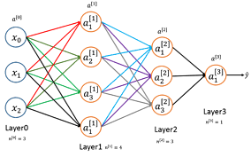
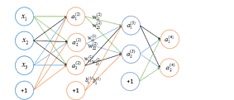
Motivation
Machine decision modeling human can help promote divergent thinking ability and creativity of machine learning
Existing machine learning lacks divergent thinking ability
Divergent thinking ability is needed for creative works, such as art, design, literary writing and scientific research, etc.
Allowing machine learning to decide with emotion.
Needed for humanized communication work
Possible Solutions
Train two distinctive networks with two group of data set

Slide 23
SubsubQ1:
How to balance local and global objectives of multiple domains?

Slide 24
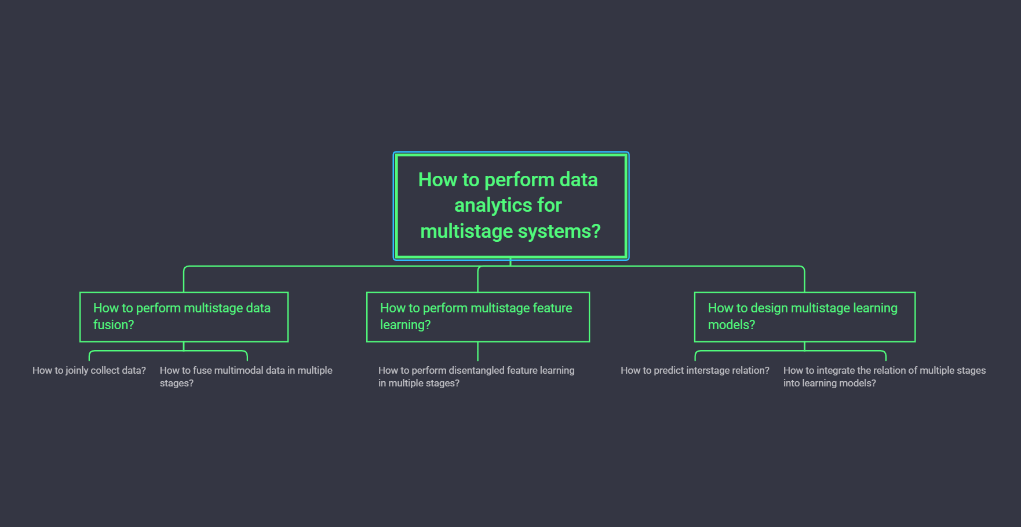

Slide 25
Problem Illustration
Given
Data from multiple domains or systems
Assumption
These domains are separated from each other, but some are interdependent.
Objective
To learn the existence of a link between two domains in a network
Topologically represent the structure within multiple domains

Slide 26
Motivation
Quantifying multiple domain relations will help:
better incorporate multimodal data of multiple resources
balance local and global objectives
Possible Solutions
To predict links through the impact of sub-domains on the global objective
Establish Multi-stage Network (MSN) through interstage link prediction
Extract weight, neighborhood and path features from MSN for further model learning

Slide 27
Student Performance Prediction: A Multistage Approach via Interstage Relation Mining
(Tentative)
ZHAO Yuqing
csyzhao1@comp.polyu.edu.hk
Notes:
Under the projects of Multistage Data Analytics and Jockey Club

Slide 28
Outline
Background
Motivation
Problem Illustration
Challenge
State of the Art
Approach and Problem Modeling
Preliminary Results
Notes:
The presentation is organized in this order.

Slide 29


Background
Hong Kong is in great need of educational data analysis.
With world-renowned universities; universities of all levels and directions of education
Improve education excellence, competitiveness and student performance, and reduce the waste of funds
Analysis of education data becomes difficult.
Conflict between old and new approach of data storage
Conflict between emergence of new data types and old analysis methods
Notes:
Hong Kong being a city with abundant educational resources and data is in great need of educational data analysis.
Not only are there world-renowned universities, but also universities of all levels and directions of education can be found in Hong Kong.
Big data analysis on education help improve education excellence, competitiveness and student performance, and reduce the waste of funds caused by unnecessary expenses.
With the emergence of technology such as online education, the analysis of educational data becomes difficult.
The old data storage approaches are not compatible with the new ways.
The emergence of new data types leaves the old analysis methods unable to achieve good results

Slide 30
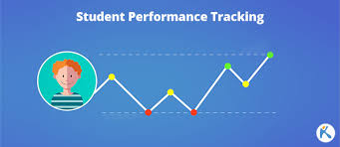
Motivation
Student performance prediction
can indicate students’ performance, achievement of learning outcomes or characteristic.
in turn can help adjust teaching reforms, enrollment and school policies
Compared with other approaches, prediction predicts continuous valued functions, and can better analyze the overall structure of the education system rather than the local impact.
Notes:
Student performance prediction is an important topic of education data mining
It can indicate student can indicate students’ performance, achievement of learning outcomes or characteristic.
in turn can help adjust teaching reforms, enrollment and school policies
Compared with other approaches like Association Rule Mining, prediction, clustering, classification, Outlier detection, Text mining, Visualization, prediction predicts continuous valued functions, and can better analyze the overall structure of the education system rather than the local impact.

Slide 31
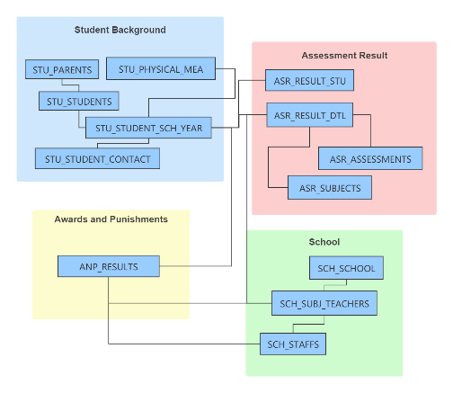
Problem Illustration
Input
Jockey Club Education data of a school ( areas )
Assumption
Education systems inherit the characteristics of the multistage systems.
Different data recording systems can be regarded as substages/ subsystems.
These stages are separated from each other but are interdependent.
Objective
Student Performance (GPA, grades, fail or not)
Notes:
Multitask learning
The ultimate goal of my topic is to better predict student performance through dynamic correlation mining of education system.
And the topic is built on the assumption that Education systems inherit the characteristics of the multistage systems:
Different data recording systems can be regarded as substages/ subsystems.
These stages are separated from each other but are interdependent.
We input jockey club education data of a school like Physical status, grades, library check-in, rewards and punishment information, family status, online course login status, clickstream data, etc.
And the objective is to predict student performance

Slide 32
Challenge
How we can quantify multistage relation
Interstage relation; Relation between global objectives and substage features/objectives
How we can better incorporate time in and between substages
The education system is not static but rather change continuously: Generating of new data overtime. With the updating of school technology and the emergence of online courses, new datasets (substages) may be generated.
How can we analyze using multimodal data?
As a complex system, there are multiple data types in the substages: Spatio-temporal data, time-stamped data, text descriptions, etc.
Notes:
There are three main challenges of the project:
How we can quantify multistage relation like Interstage relation; Relation between global objectives and substage features/objectives
How we can better incorporate time in and between substages. Since The education system is not static but rather change continuously: With the updating of school technology and the emergence of online courses, new datasets (substages) may be generated.
How we can analyze using multimodal data. As a complex system, there are multiple data types in the substages: Spatio-temporal data, time-stamped data, text descriptions, etc.

Slide 33
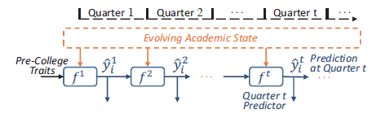
State of the Art
Data driven methods (Model education system as a single-stage)
Static Prediction [1][2]
Cons: Ignoring generating of new data and interstage connection
Progressive Prediction [3]
Cons: Adapting ensemble learning techniques and utilizing education-specific domain knowledge but ignoring connection of elements.
Fig1. Architecture of progressive prediction. Prediction results of the previous quarter can be utilized in the prediction of the current quarter.
[1] Buniyamin, Norlida, Usamah bin Mat, and Pauziah Mohd Arshad. "Educational data mining for prediction and classification of engineering students achievement." 2015 IEEE 7th International Conference on Engineering Education (ICEED). IEEE, 2015.
[2] Chen, Jiaming, Liming Luo, and Jie Song. "Course performance prediction for basic courses of universities based on support vector machine." Journal of Physics: Conference Series. Vol. 1168. No. 3. 2019.
[3] Xu, Jie, et al. "Progressive prediction of student performance in college programs." Proceedings of the Thirty-First AAAI Conference on Artificial Intelligence. 2017.
Notes:
There are mainly two kinds of current approaches on education data mining
The first kind is data driven methods that model education system as a single stage where they gather all the data together, ignoring interstage connection.
Static prediction of data driven method ignore generation of new data.
Progressive prediction of data driven methods adapts education specific domain knowledge but ignores connection of elements.

Slide 34
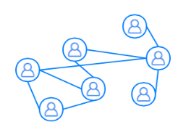
State of the Art
Graph-theoretic methods[4][5] (Fully connect every element of a single-stage)
Social Learning Network (Network between learners, teachers, and subjects)
Cons: Requires full knowledge about microscopic details. Hard to compute for large and complex systems. People oriented, can only be applied to limited education scenarios,
Network Topology
Data preprocessing
Features
Model Learning
Fig2. Summary of the SLN link prediction methodology
[4] Yang, Tsung-Yen, Christopher G. Brinton, and Carlee Joe-Wong. "Predicting learner interactions in social learning networks." IEEE INFOCOM 2018-IEEE Conference on Computer Communications. IEEE, 2018.
[5] Brinton, Christopher G., and Mung Chiang. "MOOC performance prediction via clickstream data and social learning networks." 2015 IEEE conference on computer communications (INFOCOM). IEEE, 2015.
Notes:
The second kind of method is graph theoretic methods that person orientally model the education system as a social learning network that connect every learner, teacher and subject.
It requires full knowledge about microscopic details, which is hard to compute for large and complex systems. And it’s people oriented, which makes it hard to be applied to other education scenarios

Slide 35
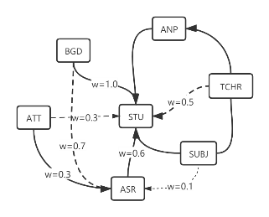
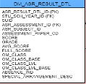


Approach and Problem Modeling
Establish Multi-stage Network (MSN).
Extract weight, neighborhood and path features from MSN
Predict student performance using integrated features.
Time Series Features
Neighborhood
Features
ASR
Association Rule Mining
Feature
importance
Prediction Model
Weight
ATT
ANP
Path Features
Notes:
My topic adopts different methodologies.
In my work, a multistage network is established, and I extract weight neighborhood and path feature from the MSN. And I predict student performance using integrated features in the prediction model

Slide 36
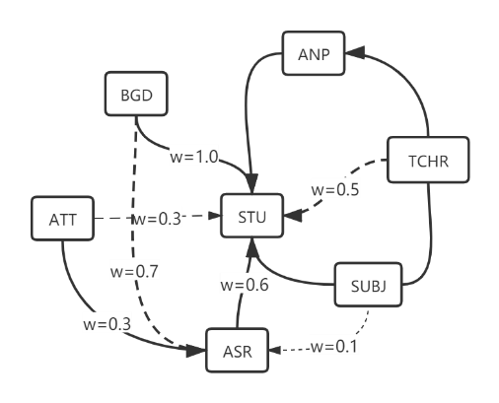
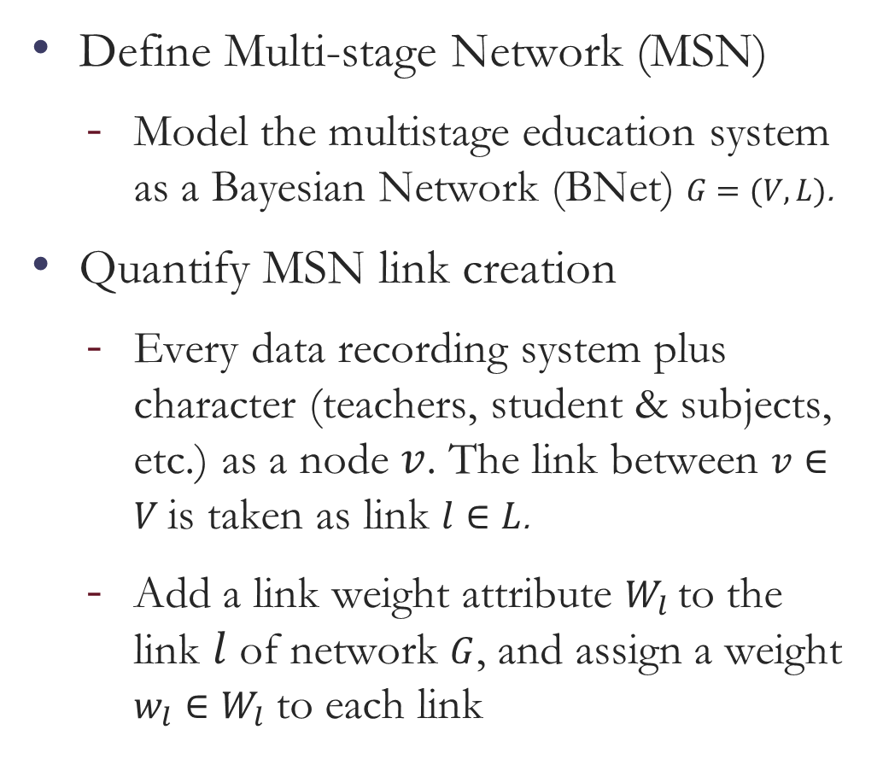
Approach and Problem Modeling
Define Multi-stage Network (MSN)
Model the multistage education system as a Bayesian Network (BNet) ­$G=(V,L)$.
Quantify MSN link creation
Every data recording system plus character (teachers, student & subjects, etc.) as a node $v$. The link between $v∈V$is taken as link $l∈L$.
Add a link weight attribute $W_{l}$to the link $l$ of network $G$, and assign a weight $w_{l}∈W_{l}$ to each link
Notes:
Here is how I model the Multistage Network.
I model the multistage education system as a Bayesian network
Secondly, I quantify MSN links modeling the stage as nodes, and assign a weight to the edges.

Slide 37
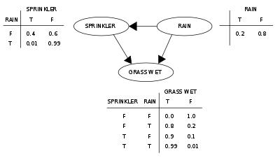
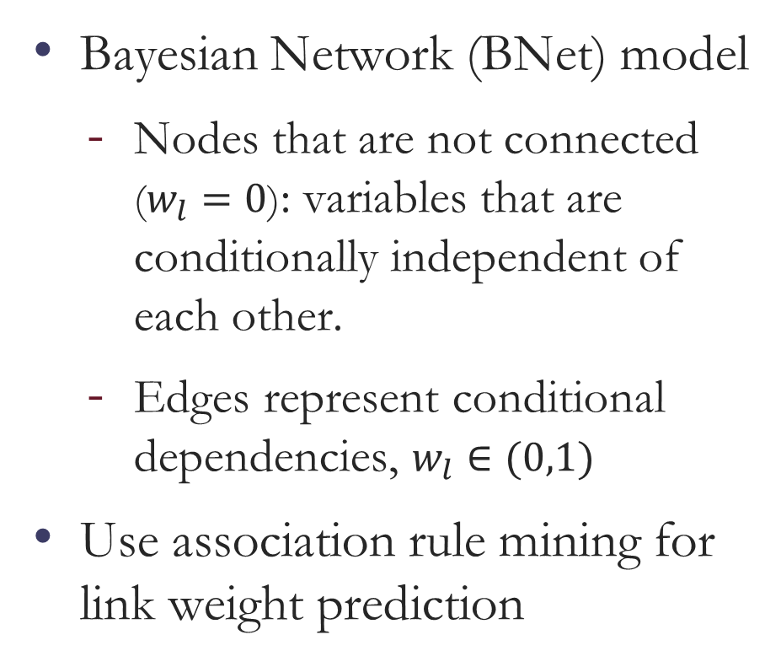
Link prediction algorithms
Bayesian Network (BNet) model
Nodes that are not connected ($w_{l}=0$): variables that are conditionally independent of each other.
Edges represent conditional dependencies, $w_{l}∈(0,1)$
Use association rule mining for link weight prediction
Notes:
Bayesian networks are directed acyclic graphs (DAGs) whose nodes represent variables in the Bayesian sense: they may be observable quantities, latent variables, unknown parameters or hypotheses. Edges represent conditional dependencies; nodes that are not connected (no path connects one node to another) represent variables that are conditionally independent of each other.
The link weight will be determined by using association rule mining.

Slide 38

Preliminary Results
Jockey Club education data sets
Preprocess
Chose data over 2017
Group student by awards and punishments
Draw the performance distribution of each groups
ANOVA analysis on the four groups
Notes:
I have preprocessed the data.
And here are the preliminary results
I have the jockey club education data set of a school that contains Physical status, grades, rewards and punishment information, and others.
I preprocessed the data by choosing data over 2017, and I grouped the student by awards and punishments.

Slide 39
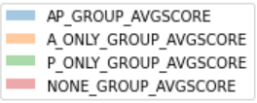
Preliminary Results
Jockey Club education data sets
Preprocess
Chose data over 2017
Group student by awards and punishments
Draw the performance distribution of each groups
ANOVA analysis on the four groups
Notes:
I have preprocessed the data.
And here are the preliminary results
I have the jockey club education data set of a school that contains Physical status, grades, rewards and punishment information, and others.
I preprocessed the data by choosing data over 2017, and I grouped the student by awards and punishments. Therefore there are four groups like in the picture: group of student that had both punishment and awards, group of students that have only awards…
I drew the performance distribution of each groups, and used anova analysis on the four groups.

Slide 40
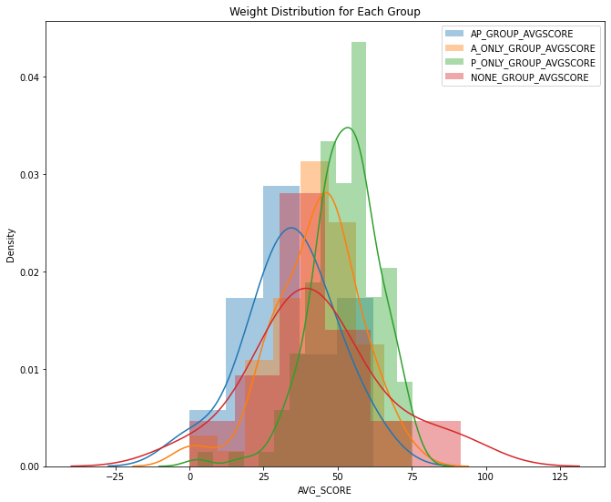
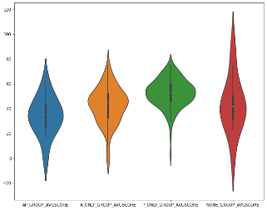
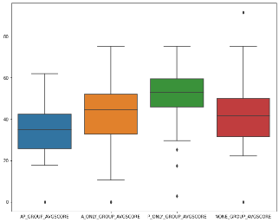
Preliminary Results
Notes:
Here is the distribution of each group
The vertical axis represent the density of student,
The horizontal axis represent the performance of students.
And also the box plot and violin plot of distribution of student group performance

Slide 41
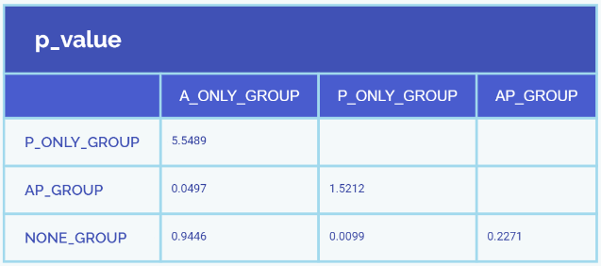
Preliminary Results
ANOVA
Used for significance test of difference between two or more samples
Notes:
ANOVA is Used for significance test of difference between two or more samples
P_value<0.05 it indicates that there are statistical significant differences between data groups

Slide 42
Preliminary Results
P_value<0.05
This indicates that there are statistical significant differences between data groups
Notes:
ANOVA uses variance-based F test to check the group mean equality.
P_value<0.05
This indicates that there are statistical significant differences between data groups

Slide 43
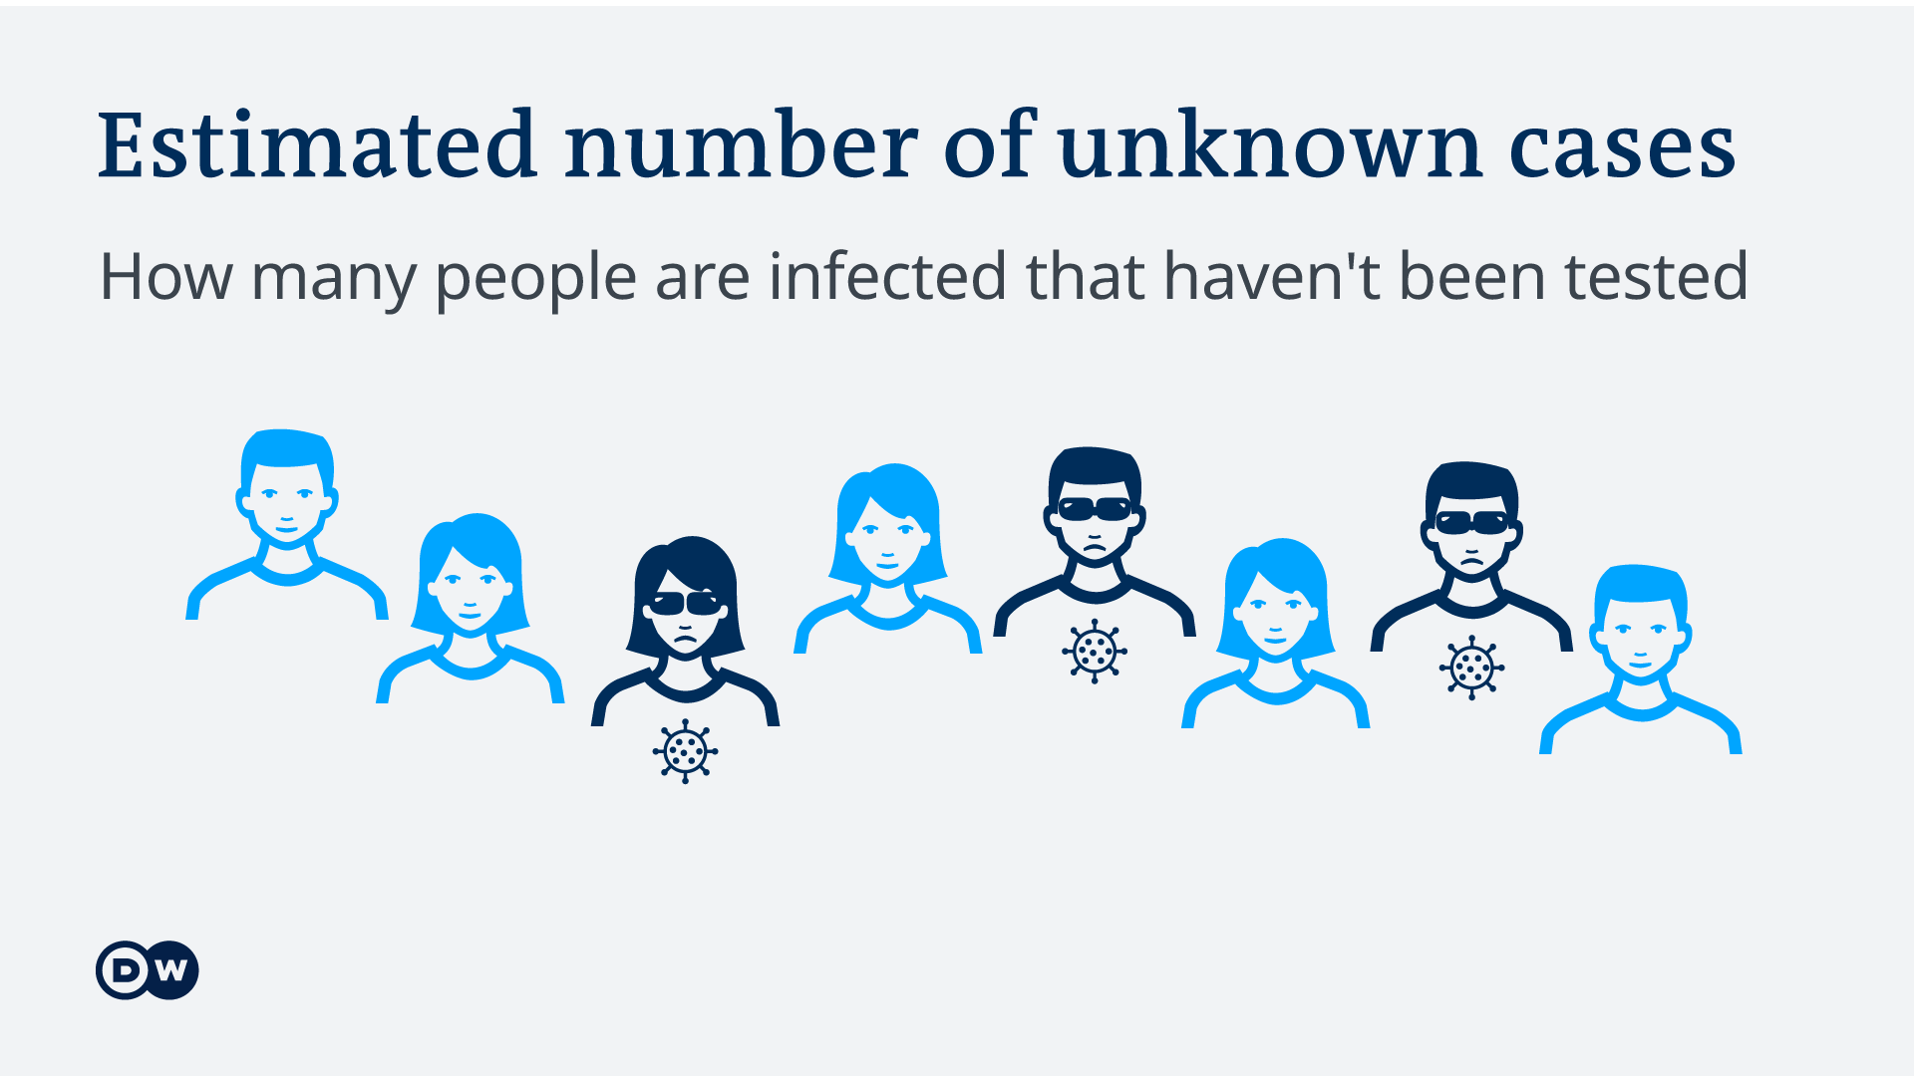
It depends on a country's testing capacity and how many people are willing to be tested.

